Slide 1


Washington Housing, Tax Fairness &
Assessment Equity
A measurement-first approach grounded in IAAO standards and Washington DOR ratio practice
What this deck does
1) Separates affordability from tax incidence
2) Defines regressivity vs. assessment equity
3) Shows what we can measure now
4) Proposes a low-risk pilot for continuous monitoring
Prepared for legislative and stakeholder discussion
v1.0
Notes:
[Sources] - Washington State Capitol photo (Wikimedia Commons): https://upload.wikimedia.org/wikipedia/commons/thumb/9/90/The_Washington_State_Capitol.jpg/600px-The_Washington_State_Capitol.jpg - Washington state outline map (public domain): https://commons.wikimedia.org/wiki/File:Washington-state-map_h.svg [/Sources]

Slide 2
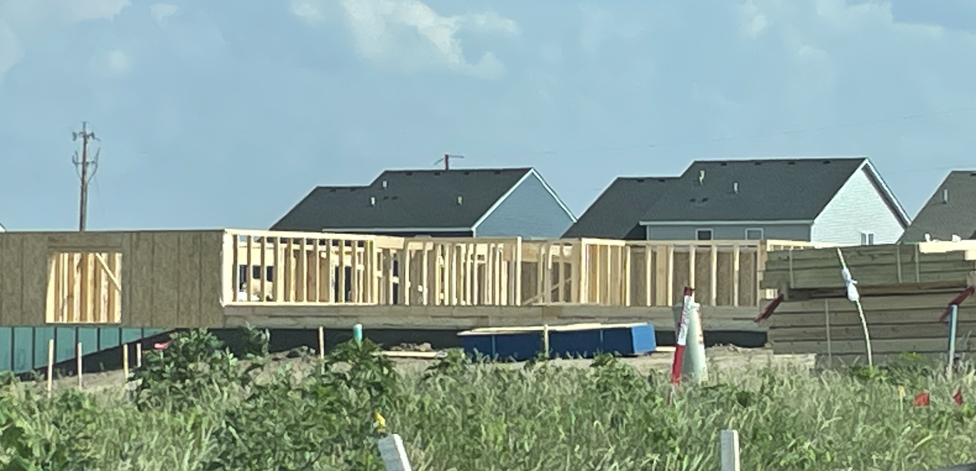
Executive map
Two priorities: housing supply / affordability, and tax fairness / regressivity
Framing
Core distinction (policy-safe)
What’s controllable (assessment administration)
Affordability is driven primarily by supply constraints, financing, and construction inputs.
Tax fairness is an incidence question (tax as % of income).
Assessment equity is narrower: whether the property tax base is applied proportionally across value tiers (vertical equity).
Maintain level of assessment (median ratio)
Maintain uniformity (COD)
Maintain vertical equity (PRD / price-related bias)
Monitor appeal pressure as an outcome signal
Housing-form change increases valuation complexity →
measurement protects fairness
Measurement-first framing
Notes:
[Sources] - IAAO: Standard on Ratio Studies (performance measures incl. PRD): https://www.iaao.org/wp-content/uploads/Standard_on_Ratio_Studies.pdf - Washington DOR: Measuring Real Property Appraisal Performance (IAAO median/COD benchmarks used): https://dor.wa.gov/sites/default/files/2025-01/2024RatioReport.pdf - Construction photo (Wikimedia Commons, CC BY-SA 4.0): https://commons.wikimedia.org/wiki/File:Light_Framing_Construction_Picture.jpg [/Sources]

Slide 3
Washington’s tax regressivity: what the data say
Effective state + local tax rates are higher at low incomes than at high incomes
Tax incidence
Total state + local taxes as % of family income (Washington)
Interpretation: regressivity is largely driven by the mix of taxes (especially sales & excise).
Assessment equity does not change incidence, but it prevents *additional* regressivity via tier bias in the property tax base.
Source: ITEP Who Pays? 7th Edition (Washington)
Notes:
[Sources] - ITEP Washington: Who Pays? 7th Edition (tax shares table; 2024 tax law): https://itep.org/washington-who-pays-7th-edition/ [/Sources]

Slide 4
Where property taxes fit in the regressivity story
Property taxes are a smaller share than sales/excise at low incomes
Tax incidence
Tax components as % of income (Washington)
Policy implication: If the goal is to reduce overall regressivity, sales/excise drivers dominate.
But within property tax, the key fairness lever is vertical equity (avoid tier bias).
Source: ITEP Who Pays? 7th Edition (WA)
Notes:
[Sources] - ITEP Washington: Who Pays? 7th Edition (component shares table; property & sales/excise): https://itep.org/washington-who-pays-7th-edition/ [/Sources]

Slide 5
Ad valorem property tax: what assessment can and cannot do
Assessment sets the base (value); policymakers set levies/rates
Property tax fundamentals
Tax bill ≈ Assessed Value × (Aggregate Levy / Tax Base)
Assessment equity determines whether “Assessed Value” is proportionate across properties (fair share).
Assessment can control
Assessment cannot control
Level (median ratio)
Uniformity (COD)
Vertical equity (PRD / price-related bias)
Transparency: model governance & monitoring
Whether the tax is regressive overall (incidence)
Levy decisions and caps
Household income constraints
Rent pass-through dynamics
Key idea: equity is necessary but not sufficient for affordability
Notes:
[Sources] - Washington DOR (explains assessed value-to-market ratio concepts and uses IAAO benchmarks): https://dor.wa.gov/sites/default/files/2025-01/2024RatioReport.pdf [/Sources]

Slide 6
Vertical equity: the “silent” regressivity lever inside property tax
PRD and ratio-by-value-tier plots detect price-related bias
Assessment equity
What “regressive assessment” means
Illustration (ratio-by-value decile)
If assessment ratios decline as property value rises, higher-value properties pay a smaller share of tax than intended.
IAAO flags this with PRD > 1.03 (or other price-related bias measures).
This is distinct from “property tax is regressive” (an income-incidence claim).
Label: illustrative only (not Benton data)
IAAO typical guidance: PRD ~ 0.98–1.03 suggests acceptable vertical equity (with context).
Vertical equity = proportionate treatment across value tiers
Notes:
[Sources] - IAAO Standard on Ratio Studies (PRD guidance and bias interpretation): https://www.iaao.org/wp-content/uploads/Standard_on_Ratio_Studies.pdf - IAAO Standard on Mass Appraisal (references PRD range and interpretation): https://www.iaao.org/wp-content/uploads/StandardOnMassAppraisal.pdf [/Sources]

Slide 7
Benchmarks: what “good” looks like
IAAO standards + Washington DOR performance report framing
Standards
Core metrics used in ratio studies
Metric
Typical benchmark guidance
Why it matters
Median ratio (level)
Should be near statutory target (often 0.90–1.10 for market-value systems)
Level / legality
COD (uniformity)
Residential often targeted 5–15%; nonresidential 5–20% (context matters)
Horizontal equity
PRD / PRB (vertical equity)
PRD near 1.00 (often 0.98–1.03) suggests limited price-related bias
Vertical equity
Note: benchmarks are guidance; sample size and market dispersion matter. Focus is on detecting material bias and protecting proportionality.
IAAO + WA DOR framing
Notes:
[Sources] - IAAO Standard on Ratio Studies (median/COD/PRD guidance): https://www.iaao.org/wp-content/uploads/Standard_on_Ratio_Studies.pdf - WA DOR Measuring Real Property Appraisal Performance (2024) describes median ratio and COD benchmark ranges used: https://dor.wa.gov/sites/default/files/2025-01/2024RatioReport.pdf [/Sources]

Slide 8
Benton County in context: assessment level vs peer counties
DOR indicated ratios (real property) — a “level” snapshot, not a vertical equity test
Benton & peers
Real property ratio (% of true & fair market value) — 2024 for 2025 taxes
Why this matters: maintaining level reduces the risk of systematic underassessment during fast market change.
What it does not show: vertical equity within the county (PRD / tier bias) — that requires a sales-ratio study by value strata.
Source: WA Department of Revenue — Property Tax Ratios by County (2024)
Notes:
[Sources] - WA DOR Property Tax Ratios by County: 2024 for 2025 taxes (Benton 95.8; Spokane 95.0; Yakima 92.4; Franklin 91.8): https://dor.wa.gov/sites/default/files/2025-01/2024-ratios-2025%20taxes.pdf [/Sources]

Slide 9
What “high performance” means in practice
It’s not perfection every year—it’s controlled drift with rapid correction
Operating model
A realistic definition of excellence
Guardrails that make “local methods” defensible
Excellence is not “no error.” It’s:
A stable process that detects bias early
A willingness to tolerate small short-run imperfections to avoid systematic tier bias
Governance: model updates are documented, tested, and explained
Outcomes: low COD without sales-chasing signals, PRD near 1.00, predictable appeal pressure
Version control for cost tables / models
Pre-post change testing (ratios by tier)
Publish summary metrics annually
Independent replication path (auditability)
Clear narrative to taxpayers: “fair share” across neighborhoods and value tiers
Key move: measure and publish vertical equity, not just median ratio.
This slide is a governance blueprint
Notes:
[Sources] - IAAO Standard on Ratio Studies (discussion of PRD and bias; cautions on interpretation): https://www.iaao.org/wp-content/uploads/Standard_on_Ratio_Studies.pdf - WA DOR appraisal performance report (explains why uniformity matters for proportional tax distribution): https://dor.wa.gov/sites/default/files/2025-01/2024RatioReport.pdf [/Sources]

Slide 10
Measurement-first pilot: cost-model counterfactual + equity outcomes
A low-risk evaluation design (no vendor mandate; no policy prescription)
Pilot
Design: same properties → two cost regimes → compare equity metrics
Inputs
Scenario A
Scenario B
Outputs
Qualified sales
Property characteristics
Assessment date values
Local cost tables
(existing practice)
National cost service
(baseline)
PRD / PRB
Ratio-by-tier plots
COD + median
Appeals (optional)
Why it’s legislator-safe: this produces evidence without prescribing a tool, vendor, or mandate.
Deliverables: a short public report + reproducible appendix (methods, stratification, sensitivity checks).
Pilot template aligned with IAAO ratio-study practice
Notes:
[Sources] - IAAO Standard on Ratio Studies (design, stratification, PRD interpretation): https://www.iaao.org/wp-content/uploads/Standard_on_Ratio_Studies.pdf [/Sources]

Slide 11
HB 1108 (2025–26): the Legislature already chose the “study first” approach
Bill status: passed Legislature; governor vetoed (May 20, 2025)
Legislative context
What HB 1108 did (in concept)
Status + why it matters now
Shifted from a legislative task force to a WSIPP-led study
Focus: primary cost drivers for homeownership and rental housing
Emphasized evidence, stakeholder input, and an analytical deliverable
Key takeaway: the policy model was “measure first.”
Bill summary shows “Gov vetoed”
Even without HB 1108, the analytic need remains
A narrower pilot can be funded at low cost
Proposal: add a focused “assessment equity / cost-model assumptions” workstream to any future housing cost-driver analysis.
Low-risk: descriptive outputs; no mandates.
HB 1108 context
Notes:
[Sources] - WA Legislature bill summary for HB 1108 (status shows Gov vetoed; actions list includes May 20, 2025): https://app.leg.wa.gov/billsummary/?BillNumber=1108&Initiative=false&Year=2025 - House bill report E2SHB 1108 (WSIPP study summary): https://lawfilesext.leg.wa.gov/biennium/2025-26/Pdf/Bill%20Reports/House/1108-S2.E%20HBR%20PL%2025.pdf [/Sources]

Slide 12
HB 2269 (2025–26): middle housing in unincorporated areas
Housing-form change increases the need for accurate costing and transparent equity monitoring
Legislative context
What HB 2269 proposes (high level)
Why this intersects with tax fairness
Clarifies middle housing can include up to four units per lot
Limits “more restrictive” standards for middle housing vs detached single-family (objective regs allowed)
In certain rural contexts, allows large on-site sewage systems as an alternative to public sewer
Practical effect: more unit types and more infrastructure variance—harder to model with one-size-fits-all assumptions.
As housing types diversify:
Replacement-cost relationships become less linear
Quality/condition grading matters more
Stratification by housing form becomes necessary
Errors can concentrate by tier → perceived unfairness
Measurement-first response: encourage annual equity reporting by major housing forms and value tiers.
HB 2269 context
Notes:
[Sources] - WA Legislature bill summary (HB 2269): https://app.leg.wa.gov/billsummary?BillNumber=2269&Initiative=false&Year=2025 - HB 2269 bill text PDF (objective standards; large on-site sewage system language): https://lawfilesext.leg.wa.gov/biennium/2025-26/Pdf/Bills/House%20Bills/2269.pdf [/Sources]

Slide 13
Why this is actionable for Rep. Bernbaum (SP)
Aligns with housing supply and fairness, without mandates
Stakeholder fit
Three “safe” levers that reinforce supply and fairness
1) Transparency standard (reporting)
Annual public reporting of median ratio, COD, and a vertical equity measure (PRD/PRB or tier plots) by major property class.
2) Voluntary pilot (evidence)
One-county or multi-county pilot comparing cost assumptions against vertical equity outcomes (descriptive only).
3) Capacity enablement (implementation)
Small modernization support for data quality, modeling, and ratio-study tooling—so supply reforms don’t break administrative fairness.
These actions are compatible with pro-supply policy
Notes:
[Sources] - Rep. Bernbaum official profile (committee membership): https://leg.wa.gov/legislators/member/adam-bernbaum - ITEP Washington distributional data (regressivity evidence): https://itep.org/washington-who-pays-7th-edition/ [/Sources]

Slide 14
A simple public dashboard that would raise trust (and lower noise)
Regular updates, automated ingestion, and outcomes that are easy to explain
Operationalization
Three panels (minimal, meaningful)
Panel A — Level & uniformity
Panel B — Vertical equity
Panel C — Outcomes
Median ratio (by class)
COD (by class)
Confidence/coverage notes
PRD/PRB or tier plots
Neighborhood strata checks
Flag “tilt” thresholds
Appeal rate by tier
Change magnitude
Resolution cycle time
Automate ingestion: annual ratio outputs + appeals + basic operational stats. Publish with plain-English narratives.
Dashboard concept
Notes:
[Sources] - IAAO Standard on Ratio Studies (core metrics; stratification concepts): https://www.iaao.org/wp-content/uploads/Standard_on_Ratio_Studies.pdf - WA DOR (ratio studies used for performance evaluation; median ratio & COD benchmarks): https://dor.wa.gov/sites/default/files/2025-01/2024RatioReport.pdf [/Sources]

Slide 15
The thesis
Washington can pursue more housing supply while improving tax fairness—
if we measure what matters and prevent assessment tier bias.
One ask:
Adopt a measurement-first approach: publish equity metrics (including vertical equity) and run a low-cost pilot before prescribing tools.
Thank you.
Notes:
[Sources] - ITEP Washington distributional data (regressivity context): https://itep.org/washington-who-pays-7th-edition/ - IAAO Standard on Ratio Studies (vertical equity measures): https://www.iaao.org/wp-content/uploads/Standard_on_Ratio_Studies.pdf [/Sources]

